Slide 1
ELECTRICAL SCIENCE-1 (15B11EC111) UNIT-4 Lecture-4

Slide 2
Chapter4 Steady State Analysis of Sinusoid

Slide 3
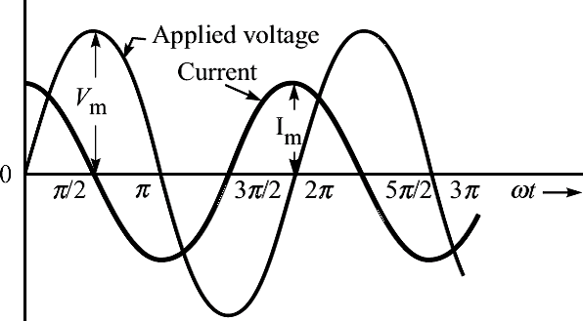
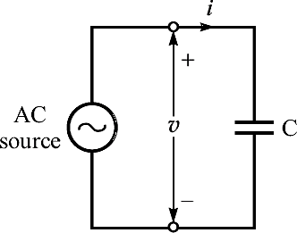
Purely Capacitive Circuit
(a) Capacitive circuit.
(b) Voltage and current waveforms.
Next

Slide 4
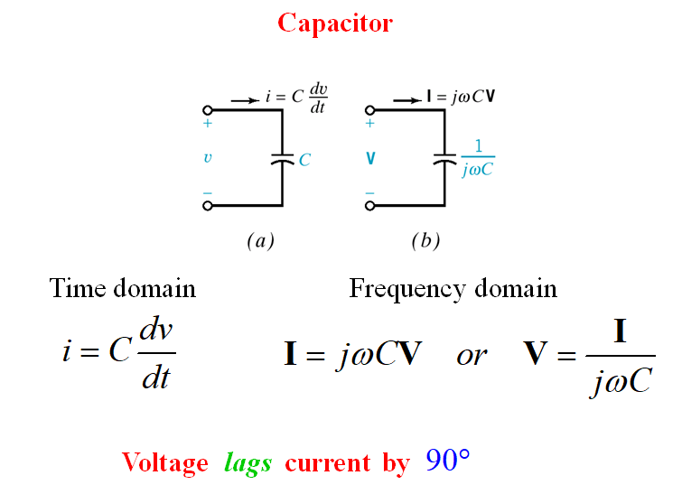

Slide 5
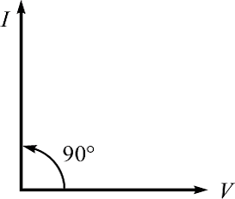
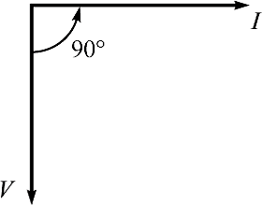
(c) Phasor diagram (with V reference).
(d) Phasor diagram (with I reference).
The current leads applied voltage by π/2.
Next

Slide 6
Analysis
We start with the applied voltage,
v = V_{m} sinωt
∴ i = C ^{dv} = C ^{d} (V sin ωt)
dt dt
m
= CV_{m}ω cos ωt = ωCV_{m} cos ωt
= ωCV_{m} sin(ωt + π/2)
If V = V∠0° = V + j0;
I = I∠90° = 0 + jI
Next

Slide 7
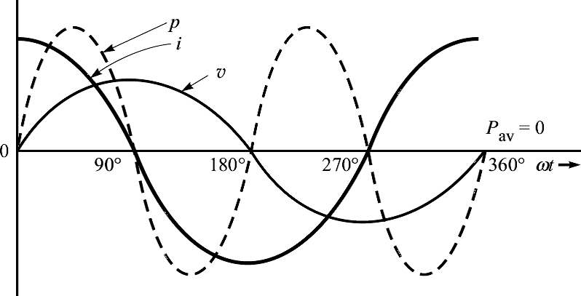
Power waveform for a purely capacitive circuit.
The average power and the power factor are given as
P = VI cosθ = VI cos90° = 0
pf = cosθ = cos90° = 0(leading)
Next

Slide 8
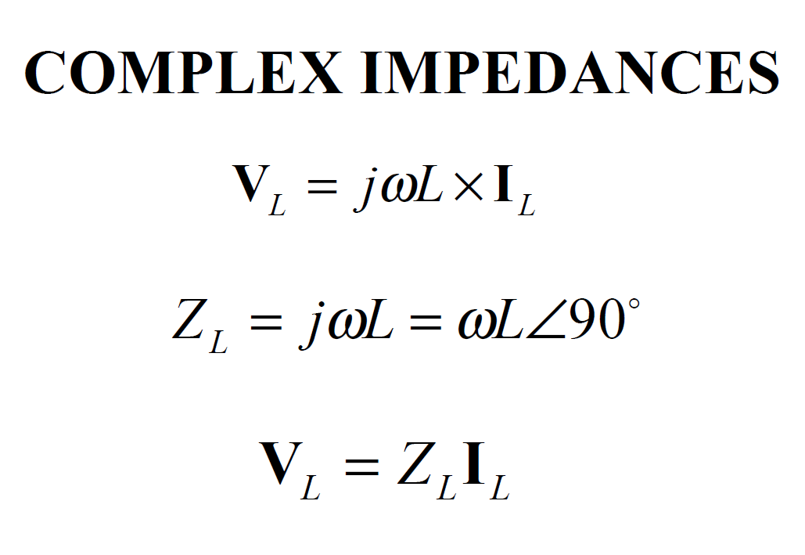

Slide 9
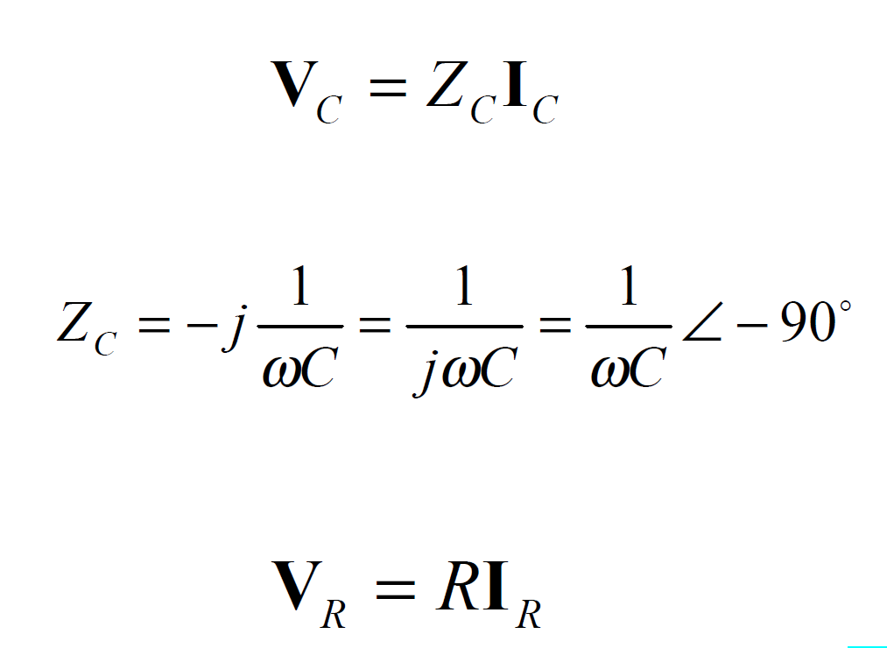

Slide 10
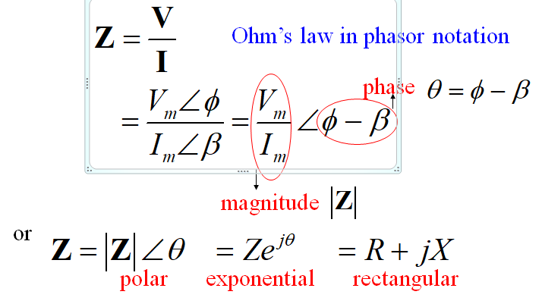
Impedance and Admittance
Impedance is defined as the ratio of the phasor voltage
to the phasor current.

Slide 11
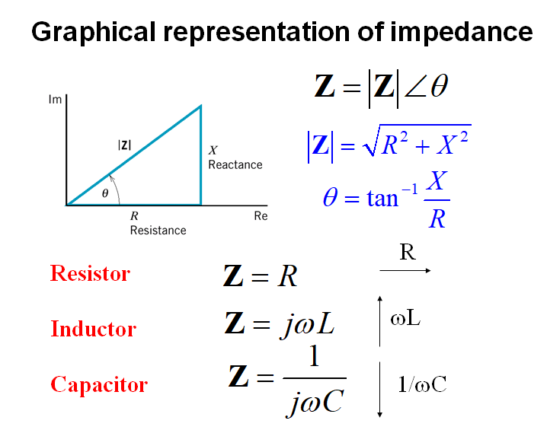

Slide 12
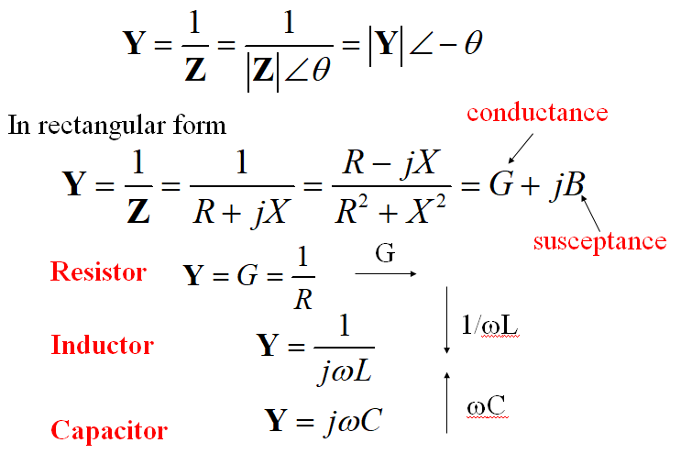
Admittance is defined as the reciprocal of impedance

Slide 13
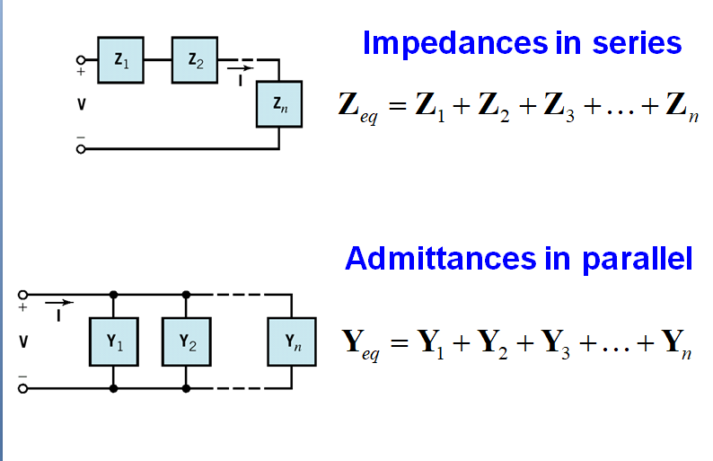

Slide 14
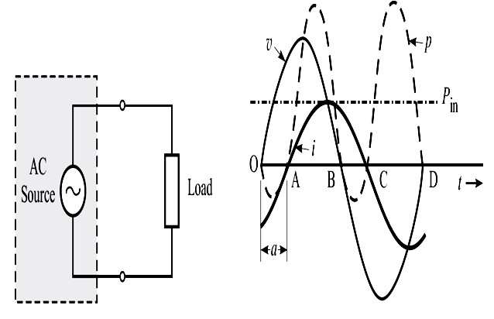
Power and Power Factor
(a) AC source delivering power to a load.
(b) Waveforms of voltage, current and power.
v = V_{m} sinωt
and i = I_{m} sin(ωt −θ )
Next

Slide 15
Let the effective values be
V = V_{m} / 2 and I = I_{m} / 2
Apparently, it seems that the power going to the load should be equal to VI.
But the real power is the average of the instantaneous power.
Let us write the expression of instantaneous power,
Next

Slide 16
p = vi = [V_{m} sin ωt][I_{m} sin(ωt −θ )] = V_{m} I_{m} sin ωt sin(ωt −θ )
= ^{Vm I m} [cos{ωt − (ωt −θ )} − cos{ωt + (ωt −θ )}]
2
₌ V_{m}
⋅ ^{I m} [cosθ − cos(2ωt −θ )] = VI[cosθ − cos(2ωt −θ )]
2 2
= VI cosθ −VI cos(2ωt −θ )
The average value of the second term is zero.
Thus, the average power or actual power or real power consumed by the load is given as
P = VI cosθ
Next

Slide 17
Power Factor
It is defined as the factor by which the apparent power is to be multiplied so as to get the real power. Thus,
power factor ( pf ) = cosθ
In case the phase angle is zero, the circuit is said to have unity pf. The real power is then same as the apparent power.
Next

Slide 18
Example 3
In an ac circuit, the instantaneous voltage and current are given as
v = 55sinωt V and i = 6.1sin (ωt −π / 5) A
Determine the average power, the apparent power, the instantaneous power when ωt (in radians) equals 0.3, and the power factor in percentage
Next

Slide 19
Solution : The phase angle, θ = π/5 The rms values are
V = ^{Vm} = ⁵⁵ = 38.89 V 2 2
I = ^{Im} = ^{6.1} = 4.31A 2 2
Therefore, the average power,
P_{av} = VI cosθ = 38.89× 4.31×cosπ / 5
= 167.62× 0.809 = 135.6 W
The apparent power,
P_{a} = VI = 38.89× 4.31 = 167.62 VA
Next

Slide 20
The instantaneous power at ωt = 0.3,
p = VI cosθ −VI cos(2ωt −θ )
= 135.6 −167.62×cos(2× 0.3 − π / 5) = −31.95 W
The power factor,
pf = cosθ = cosπ / 5 = 0.809 = 80.9%
Next

Slide 21
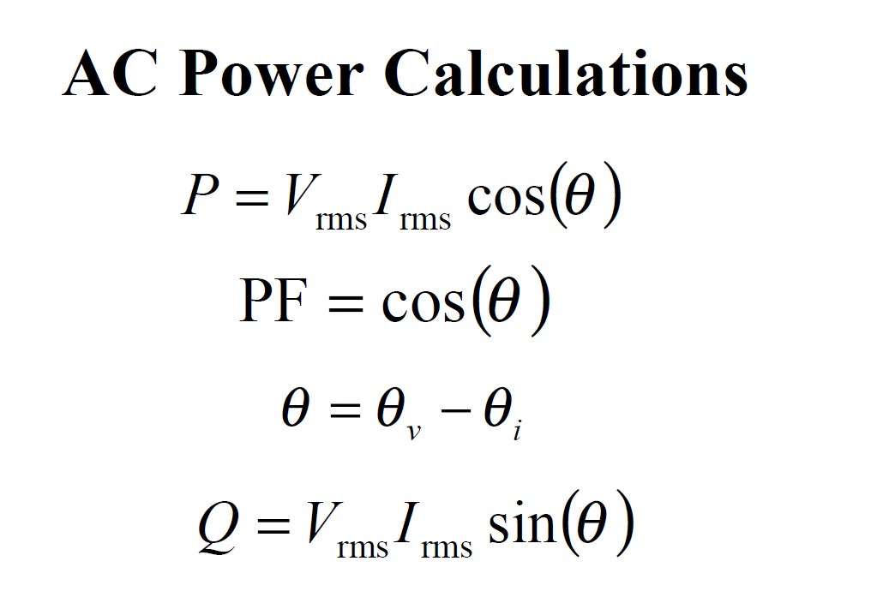

Slide 22
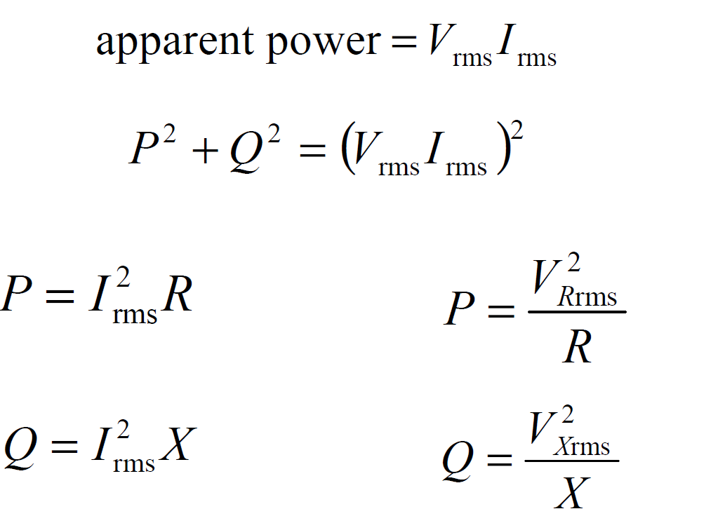

Slide 23
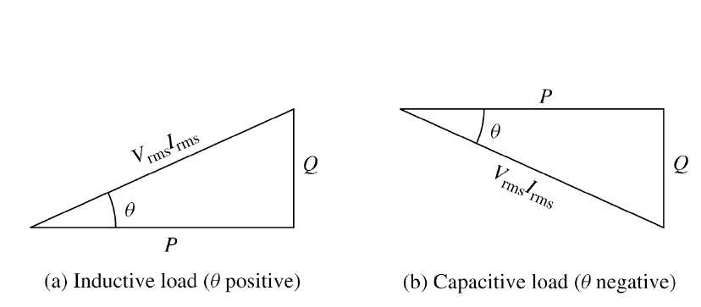

Slide 24
References
R.C. Dorf and James A. Svoboda, “Introduction to Electric Circuits”, 9th ed, John Wiley & Sons, 2013.
D.C. Kulshreshtha, Basic Electrical Engineering, Revised 1st ed, Tata Mc Graw Hill, 2017.
V. K.Mehta, Rohit Mehta, Basic Electrical Engineering, 6th ed, S. Chand Publishing, 2012.

Slide 25
Thanks

